Slide 1

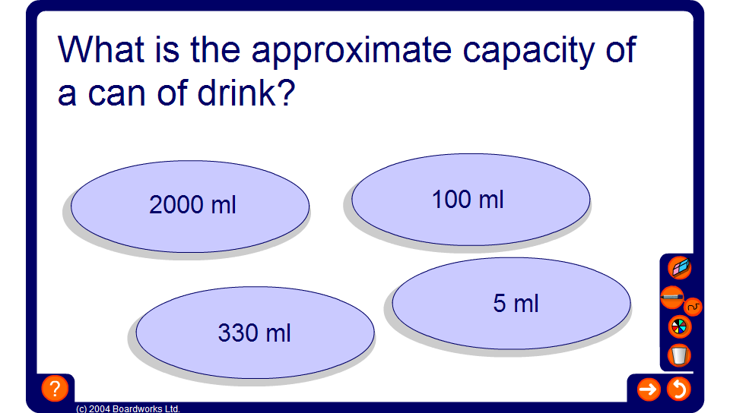


Estimating measurements
Notes:
Ask pupils to estimate the correct measurement, giving justifications for their answers.

